Slide 1
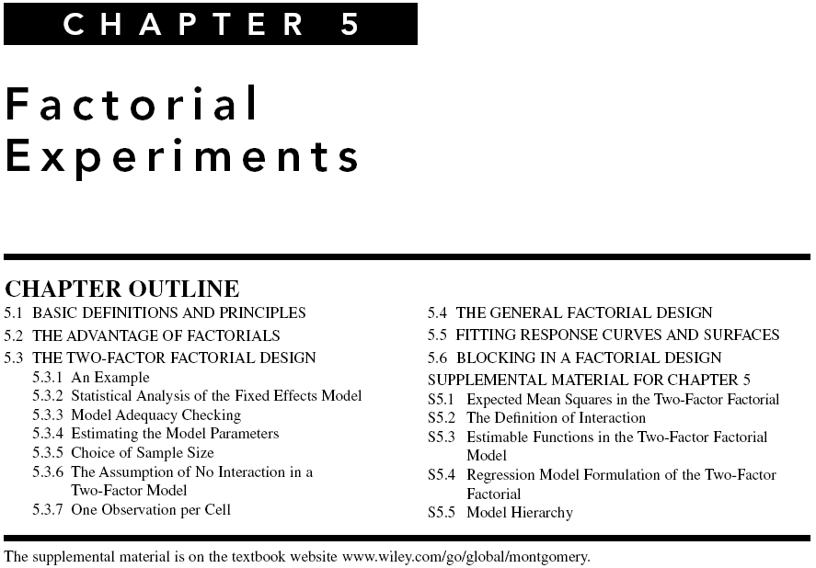

Chapter 5
Design & Analysis of Experiments 8E 2012 Montgomery

Slide 2
Design of Engineering Experiments
– Introduction to Factorials
Text reference, Chapter 5
General principles of factorial experiments
The two-factor factorial with fixed effects
The ANOVA for factorials
Extensions to more than two factors
Quantitative and qualitative factors – response curves and surfaces
Chapter 5
Design & Analysis of Experiments 8E 2012 Montgomery

Slide 3
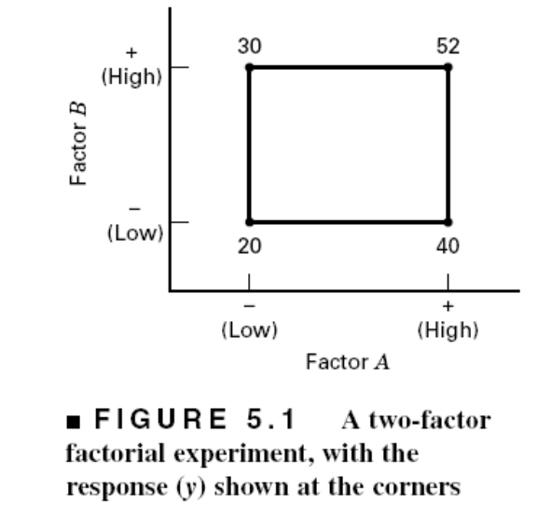
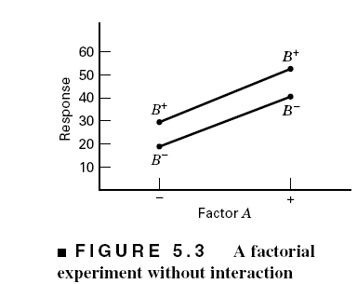
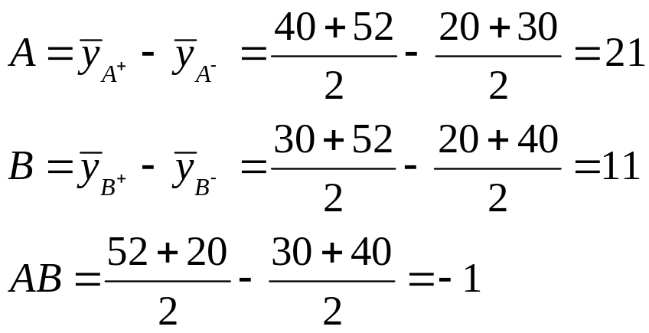
Some Basic Definitions
Definition of a factor effect: The change in the mean response when the factor is changed from low to high
Chapter 5
Design & Analysis of Experiments 8E 2012 Montgomery

Slide 4
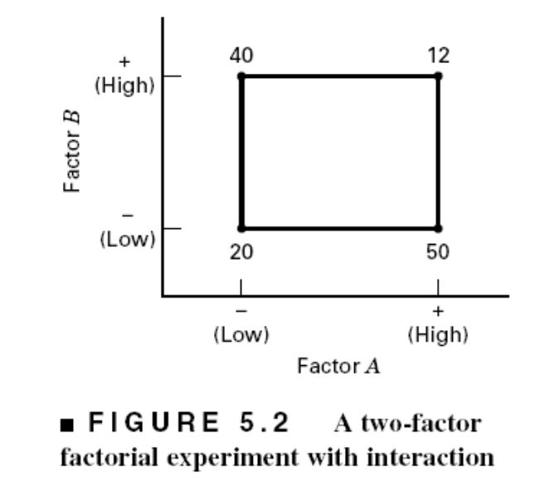
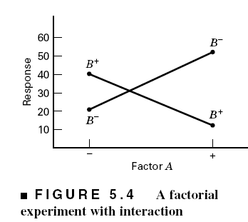
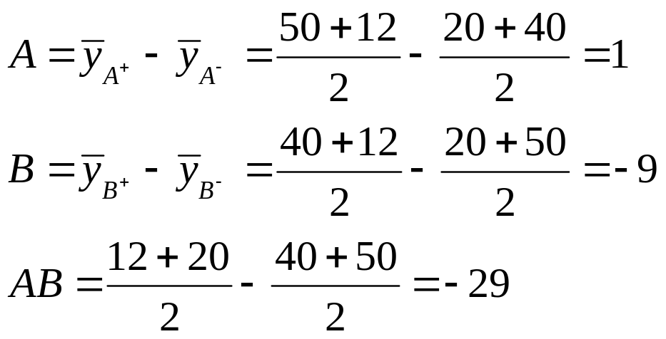
The Case of Interaction:
Chapter 5
Design & Analysis of Experiments 8E 2012 Montgomery

Slide 5
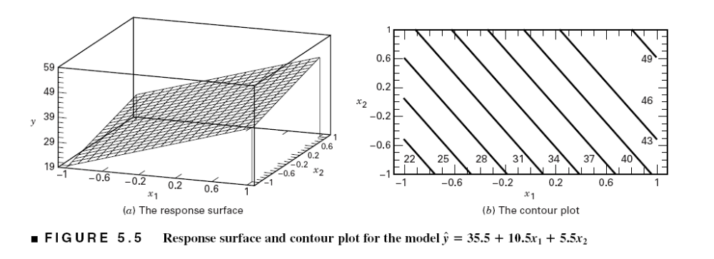
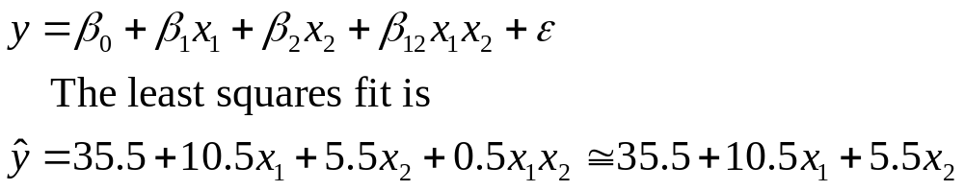
Regression Model & The Associated Response Surface
Chapter 5
Design & Analysis of Experiments 8E 2012 Montgomery

Slide 6
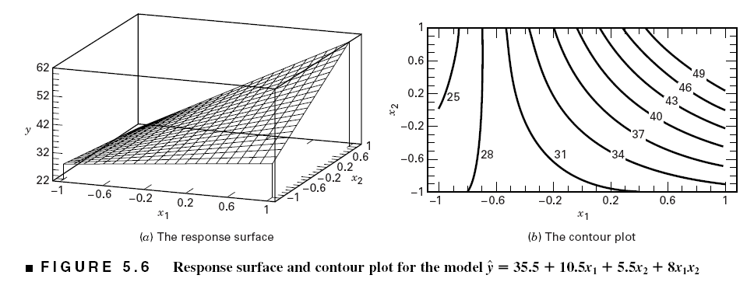
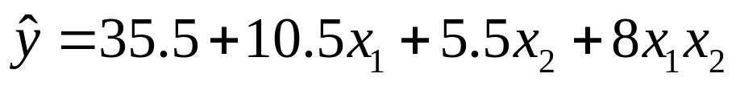
The Effect of Interaction on the Response Surface
Suppose that we add an interaction term to the model:
Interaction is actually a form of curvature
Chapter 5
Design & Analysis of Experiments 8E 2012 Montgomery

Slide 7
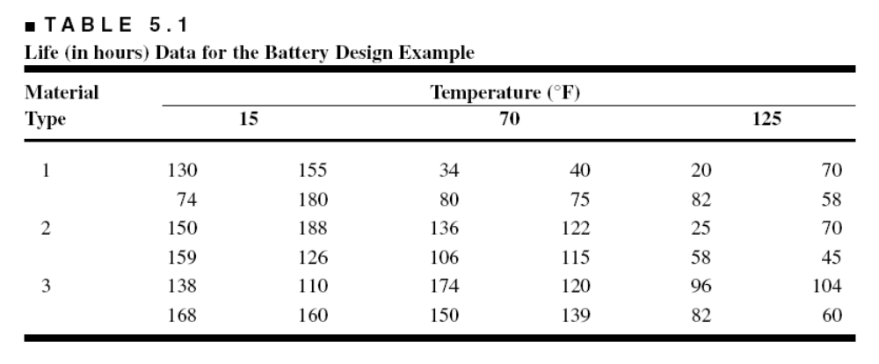
Example 5.1 The Battery Life Experiment
Text reference pg. 187
A = Material type; B = Temperature (A quantitative variable)
What effects do material type & temperature have on life?
2. Is there a choice of material that would give long life regardless of temperature (a robust product)?
Chapter 5
Design & Analysis of Experiments 8E 2012 Montgomery

Slide 8
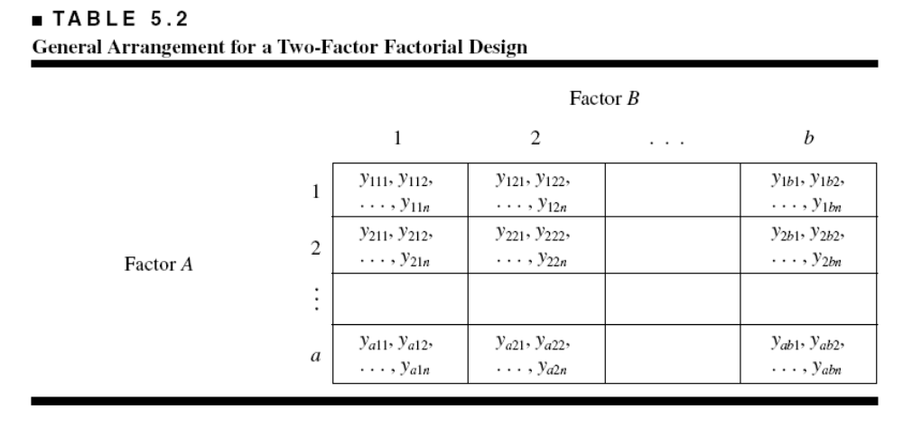
The General Two-Factor
Factorial Experiment
a levels of factor A; b levels of factor B; n replicates
This is a completely randomized design
Chapter 5
Design & Analysis of Experiments 8E 2012 Montgomery

Slide 9
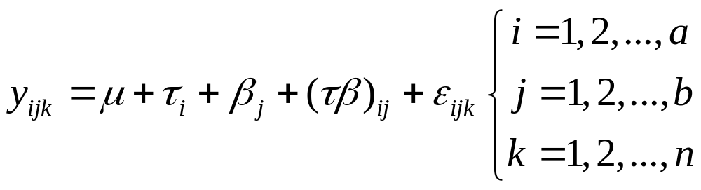
Statistical (effects) model:
Other models (means model, regression models) can be useful
Chapter 5
Design & Analysis of Experiments 8E 2012 Montgomery

Slide 10
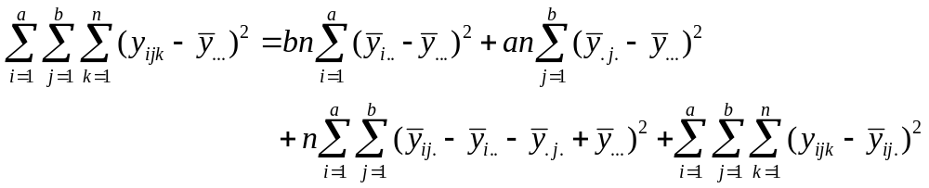
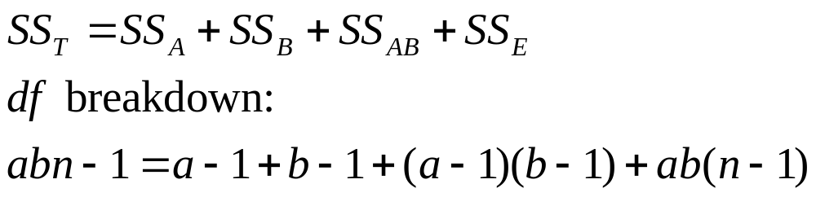
Extension of the ANOVA to Factorials (Fixed Effects Case) – pg. 189
Chapter 5
Design & Analysis of Experiments 8E 2012 Montgomery

Slide 11
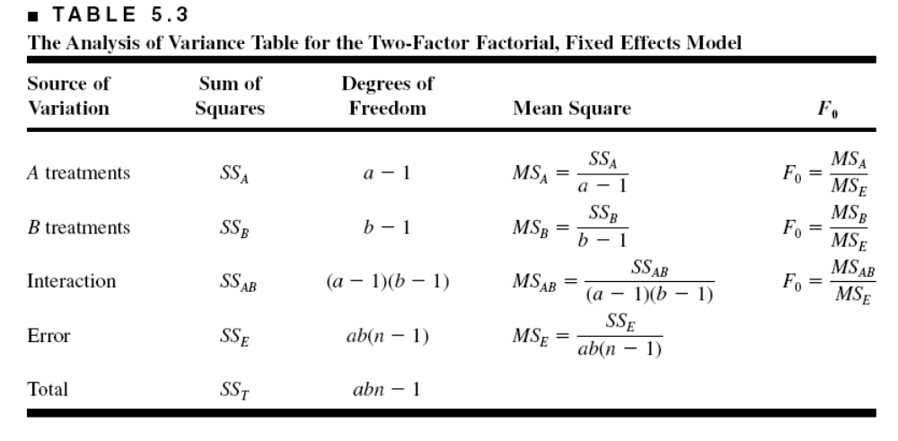
ANOVA Table – Fixed Effects Case
JMP and Design-Expert will perform the computations
Text gives details of manual computing (ugh!) – see pp. 192
Chapter 5
Design & Analysis of Experiments 8E 2012 Montgomery

Slide 12
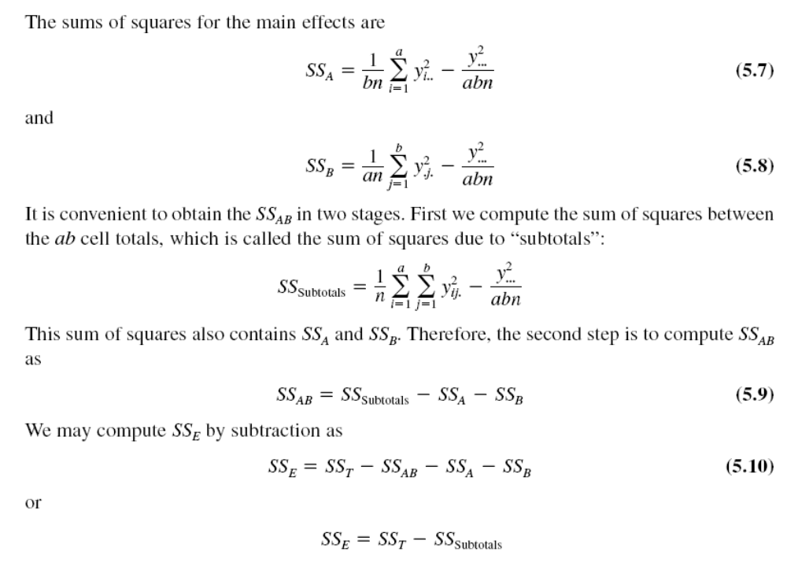
Chapter 5
Design & Analysis of Experiments 8E 2012 Montgomery

Slide 13
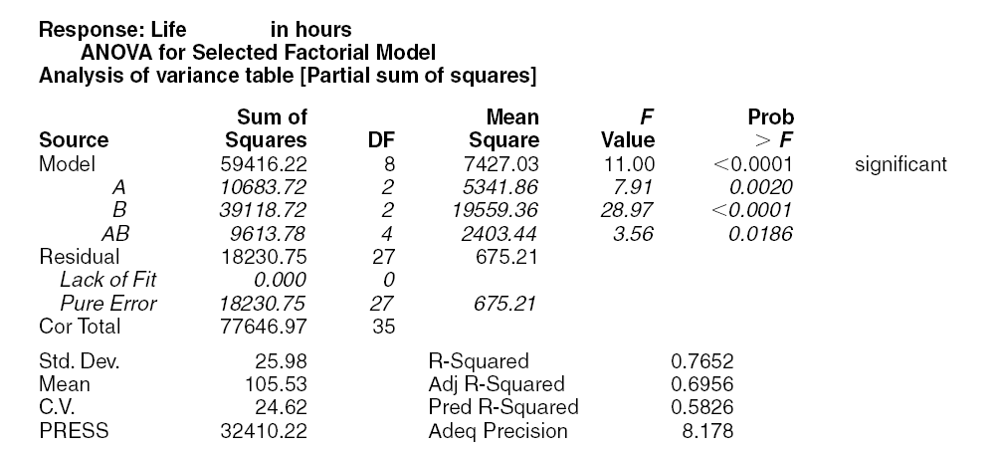
Design-Expert Output – Example 5.1
Chapter 5
Design & Analysis of Experiments 8E 2012 Montgomery

Slide 14
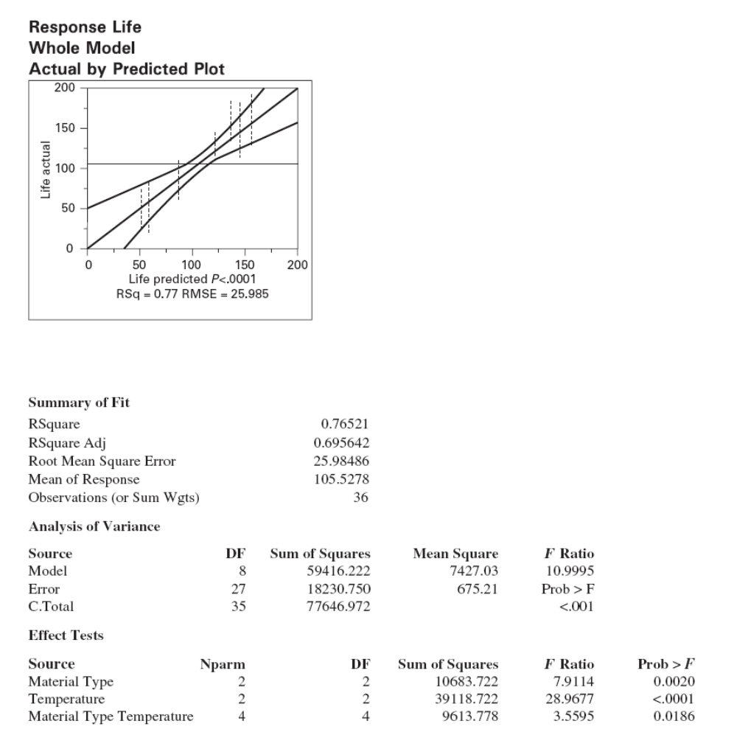
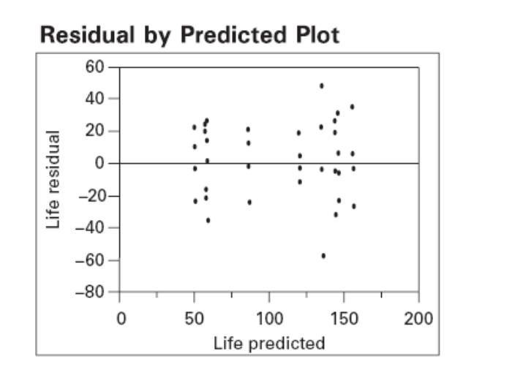
JMP output – Example 5.1
Chapter 5
Design & Analysis of Experiments 8E 2012 Montgomery

Slide 15
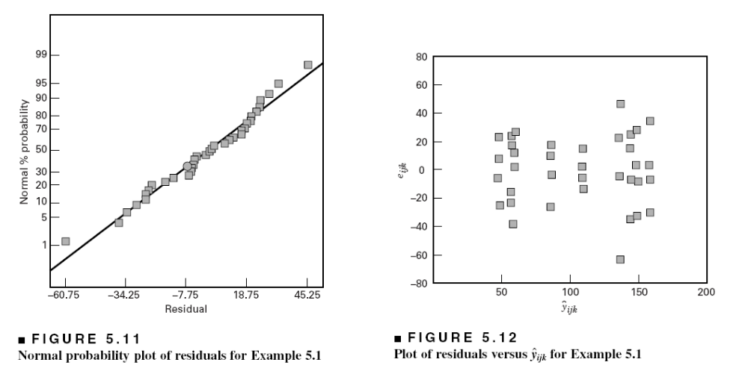
Residual Analysis – Example 5.1
Chapter 5
Design & Analysis of Experiments 8E 2012 Montgomery

Slide 16
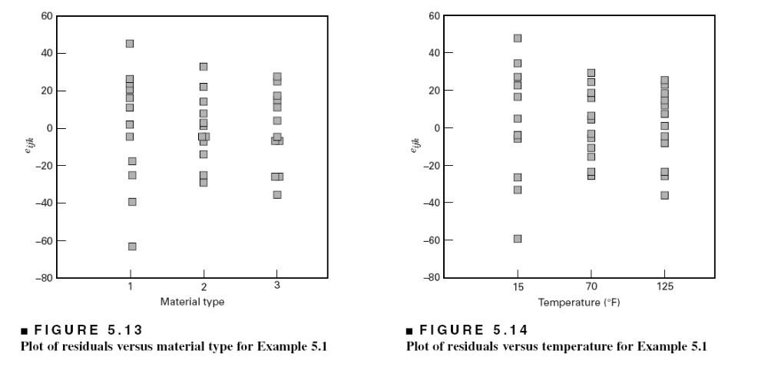
Residual Analysis – Example 5.1
Chapter 5
Design & Analysis of Experiments 8E 2012 Montgomery

Slide 17
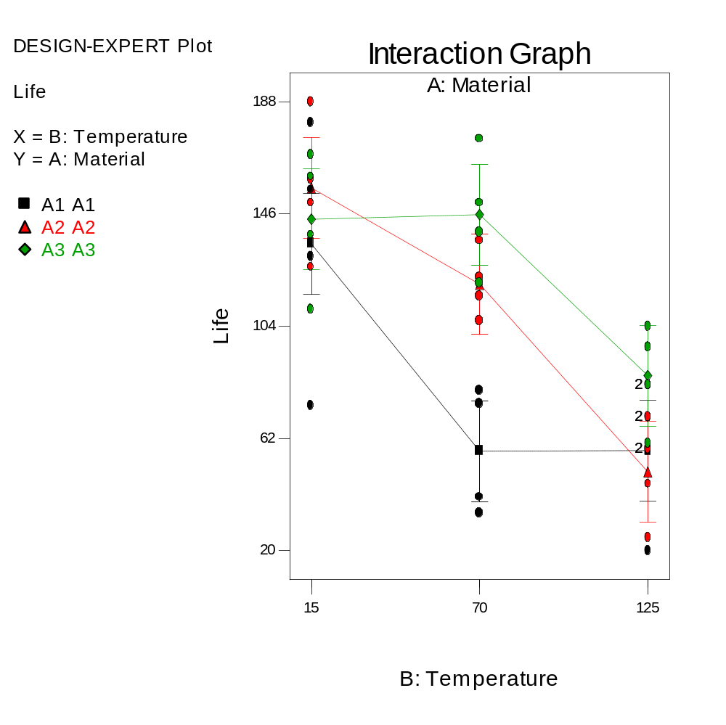
Interaction Plot
Chapter 5
Design & Analysis of Experiments 8E 2012 Montgomery

Slide 18
Quantitative and Qualitative Factors
The basic ANOVA procedure treats every factor as if it were qualitative
Sometimes an experiment will involve both quantitative and qualitative factors, such as in Example 5.1
This can be accounted for in the analysis to produce regression models for the quantitative factors at each level (or combination of levels) of the qualitative factors
These response curves and/or response surfaces are often a considerable aid in practical interpretation of the results
Chapter 5
Design & Analysis of Experiments 8E 2012 Montgomery

Slide 19
Quantitative and Qualitative Factors
A = Material type
B = Linear effect of Temperature
B² = Quadratic effect of Temperature
AB = Material type – Temp_{Linear}
AB² = Material type - Temp_{Quad}
B³ = Cubic effect of Temperature (Aliased)
Candidate model terms from Design- Expert: Intercept
A
B
B²
AB
B³
AB²
Chapter 5
Design & Analysis of Experiments 8E 2012 Montgomery

Slide 20
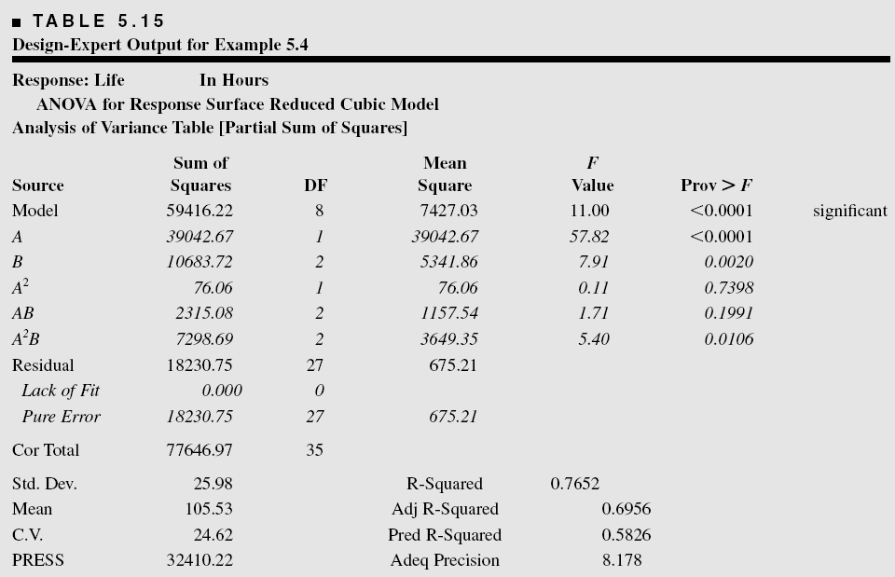
Quantitative and Qualitative Factors
Chapter 5
Design & Analysis of Experiments 8E 2012 Montgomery

Slide 21
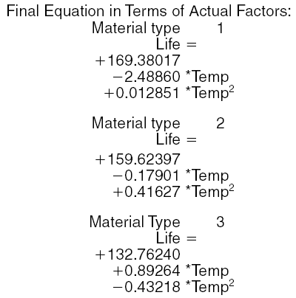
Regression Model Summary of Results
Chapter 5
Design & Analysis of Experiments 8E 2012 Montgomery

Slide 22
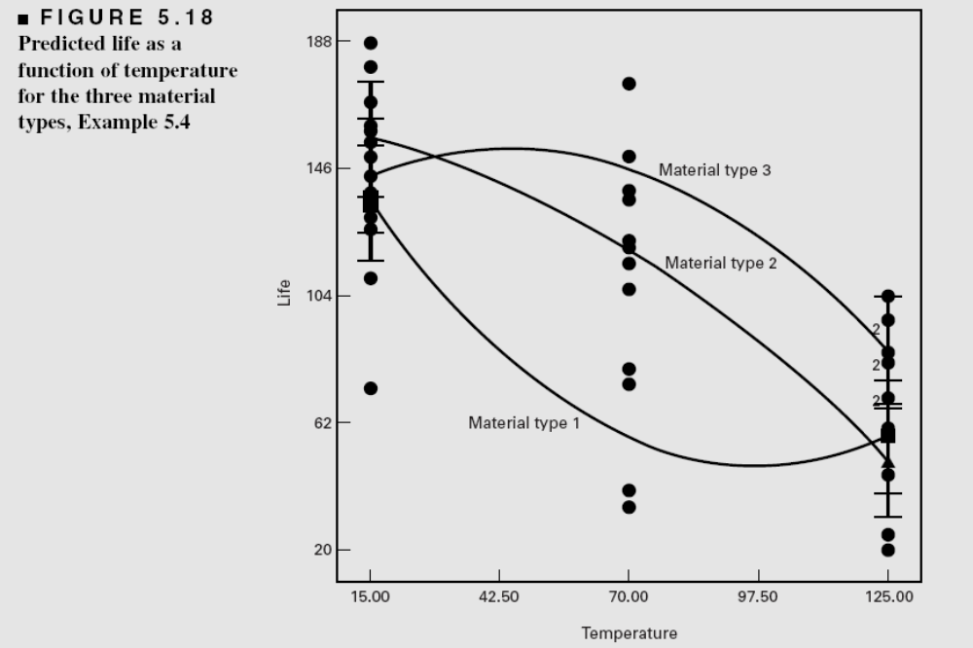
Regression Model Summary of Results
Chapter 5
Design & Analysis of Experiments 8E 2012 Montgomery

Slide 23
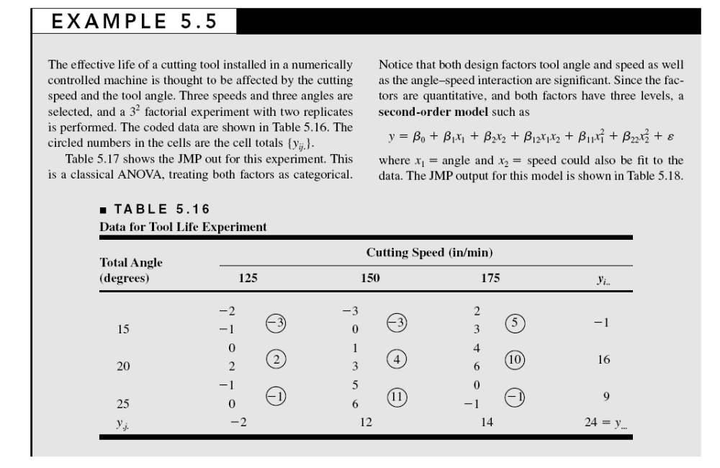
Chapter 5
Design & Analysis of Experiments 8E 2012 Montgomery

Slide 24
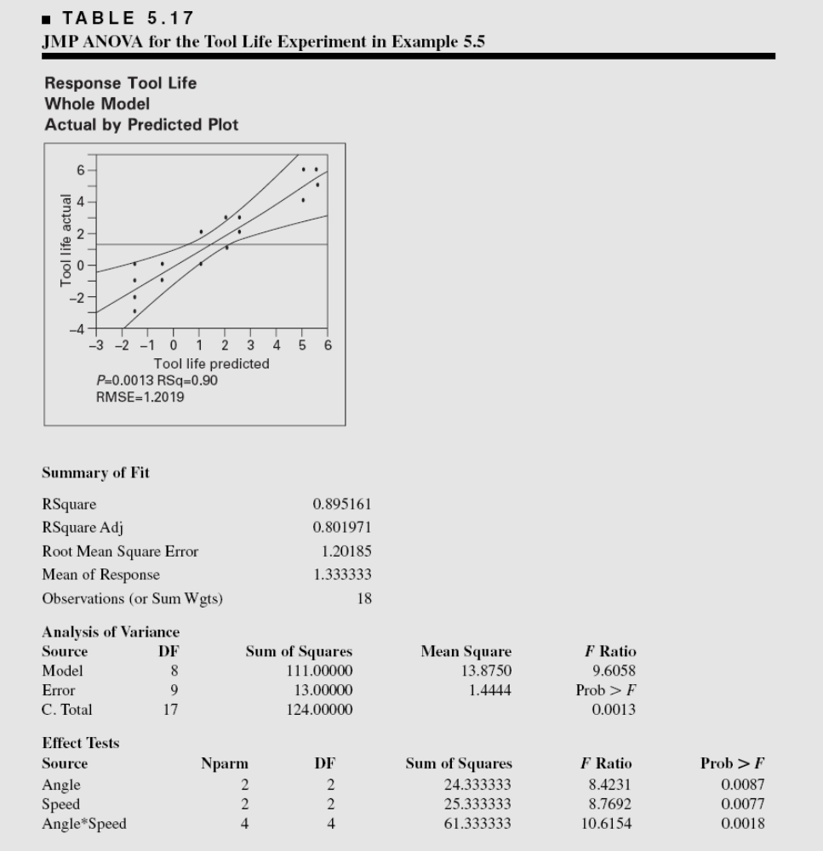
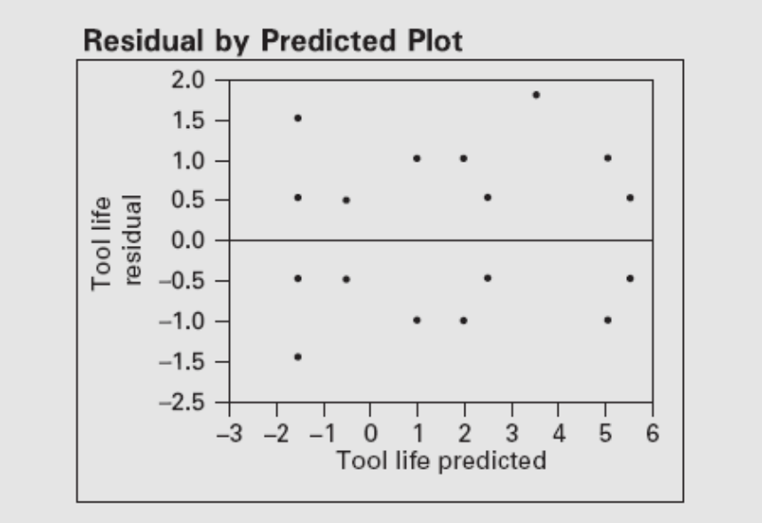
Chapter 5
Design & Analysis of Experiments 8E 2012 Montgomery

Slide 25
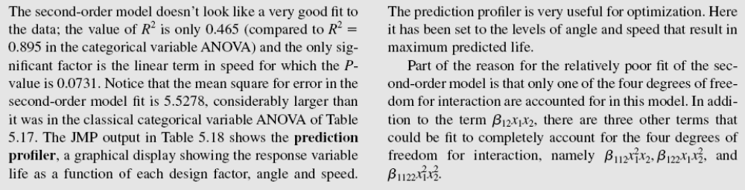
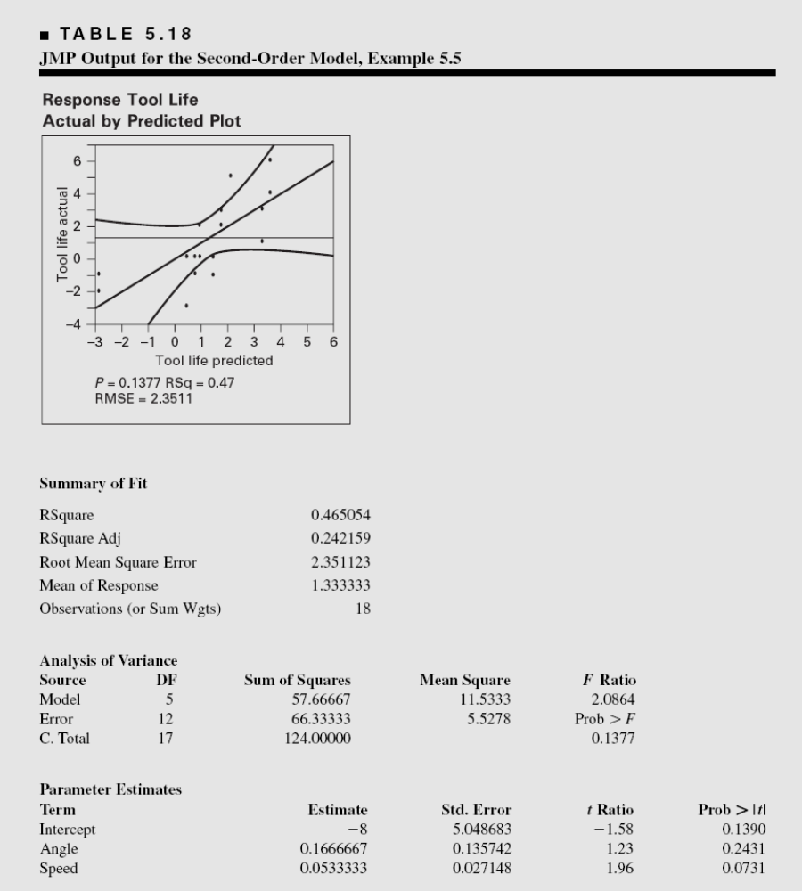
Chapter 5
Design & Analysis of Experiments 8E 2012 Montgomery

Slide 26
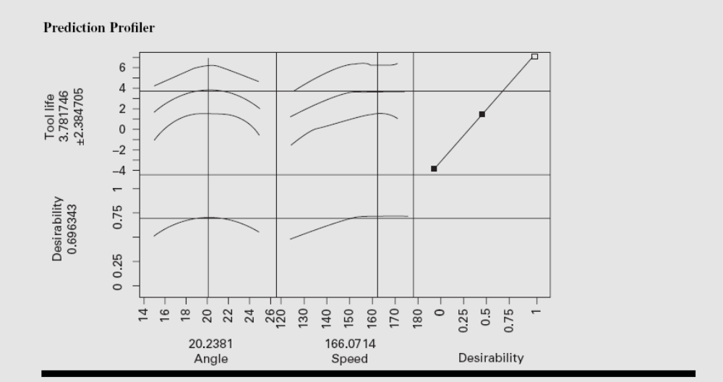
Chapter 5
Design & Analysis of Experiments 8E 2012 Montgomery

Slide 27
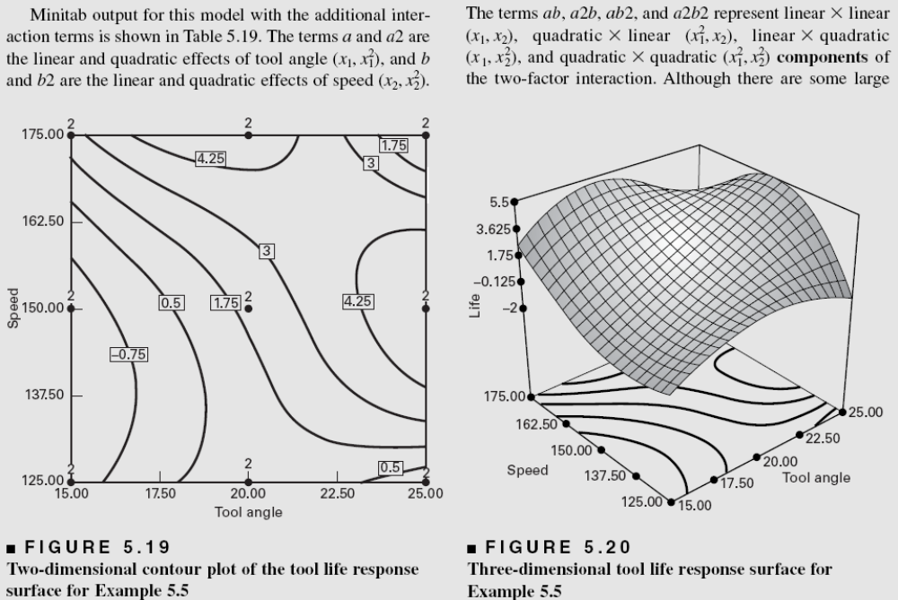
Chapter 5
Design & Analysis of Experiments 8E 2012 Montgomery

Slide 28
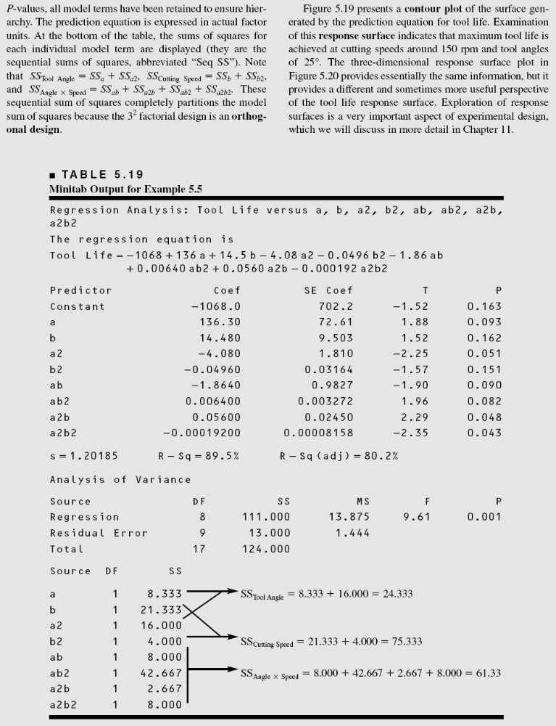
Chapter 5
Design & Analysis of Experiments 8E 2012 Montgomery

Slide 29
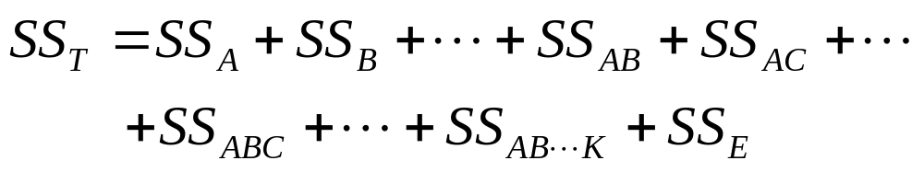
Factorials with More Than
Two Factors
Basic procedure is similar to the two-factor case; all abc…kn treatment combinations are run in random order
ANOVA identity is also similar:
Complete three-factor example in text, Example 5.5
Chapter 5
Design & Analysis of Experiments 8E 2012 Montgomery

